Slide 1




 | BANGABANDHU SHEIKH MUJIBUR RAHMAN SCIENCE AND TECHNOLOGY UNIVERSITY, GOPALGANJ, 8100
Video Game Sales Analysis: Predicting Trends with a
Regression Model
Name:Nisat Sultana Nira
Batch ID: B05020
Introduction to Programming with Python
EDGE-BSMRSTUCSE Digital Skills Training

Slide 2
In this project, we analyse historical sales data for video games from 1980 till 2020 to understand meaningful trends and patterns. By examining this data, we aim to answer key questions:
• What percent of global sales do different regions and genres generate?
• What are the top performing games and publishers?
• What charts are thrown at the wall to answer the question of how do video game sales trends change?

Slide 3
Python libraries used for data analysis and visualization.
Pandas
matplotlib.pyplot
numpy
seaborn

Slide 4
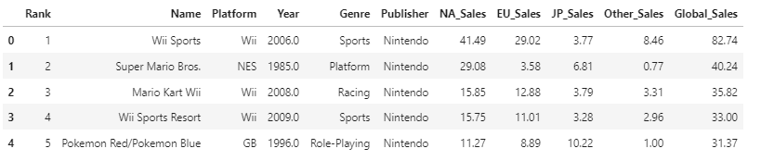
An explanation of each variable:
Rank, Name, Platform, Year, Genre, Publisher, NA_Sales, EU_Sales, JP_Sales, Other_Sales, Global_Sales
df= pd.read_csv("C:\\Users\\USER\\Downloads\\archive\\vgsales.csv") df.head(5)

Slide 5
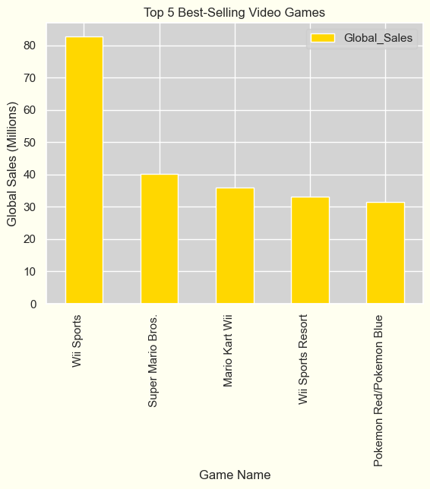
Top 5 Best-Selling Video Games Worldwide
Wii Sports – Sold 82.74 million copies.
Super Mario Bros. – Sold 40.24 million copies.
Mario Kart Wii – Sold 35.82 million copies.
Wii Sports Resort – Sold 33.00 million copies.
Pokemon Red/Pokemon Blue – Sold 31.37 million copies.
top_5_games = df[['Name', 'Global_Sales']].sort_values(by='Global_Sales', ascending=False).head(5)
print(top_5_games)
top_5_games.plot(x='Name', y='Global_Sales', kind='bar', color='gold')

Slide 6
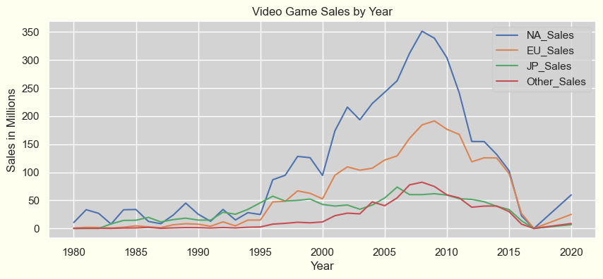
Video Game Sales by Year (1980-2020)
sales_columns = ['NA_Sales', 'EU_Sales', 'JP_Sales', 'Other_Sales']
yearly_sales = df.groupby('Year')[sales_columns].sum()
yearly_sales.plot(kind='line', figsize=(10,4))
plt.title('Video Game Sales by Year')

Slide 7
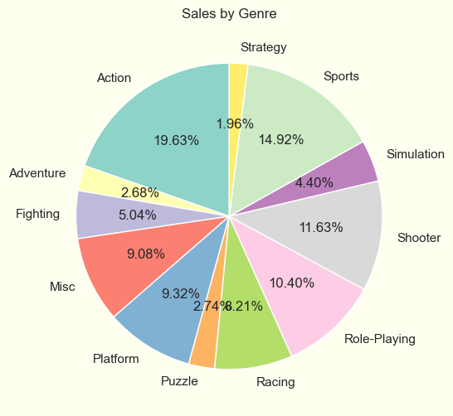
genre_sales = df.groupby('Genre')[sales_columns].sum()
genre_sales_total = genre_sales.sum(axis=1)
print(genre_sales_total)
genre_sales_total.plot(kind='pie', figsize=(10, 6), autopct='%1.2f%%', startangle=90, cmap='Set3')
Video Game Sales by Genre

Slide 8
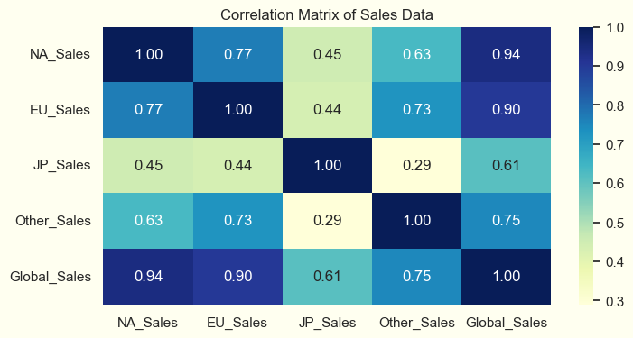
Correlation Matrix of Sales Data
corr = df[sales_columns + ['Global_Sales']].corr()
plt.figure(figsize=(8,4))
sns.heatmap(corr, annot=True, cmap='YlGnBu', fmt='.2f')

Slide 9
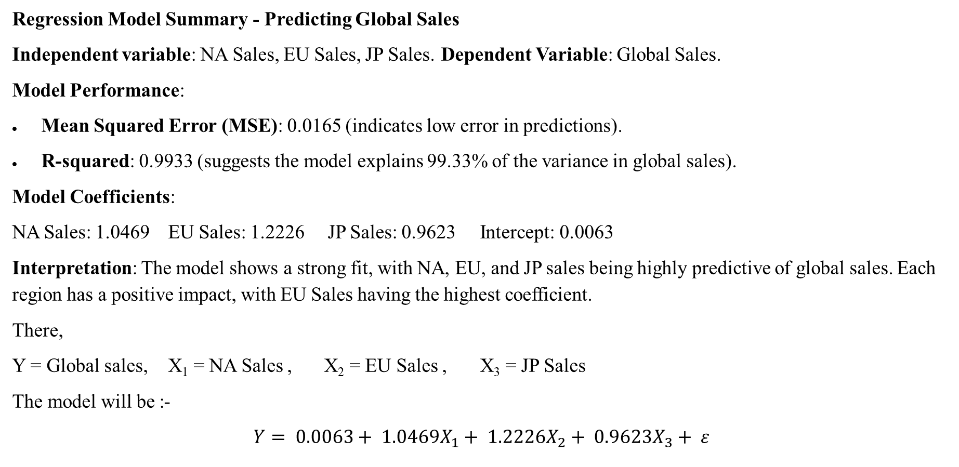
Regression Model Summary - Predicting Global Sales
Independent variable: NA Sales, EU Sales, JP Sales. Dependent Variable: Global Sales.
Model Performance:
Mean Squared Error (MSE): 0.0165 (indicates low error in predictions).
R-squared: 0.9933 (suggests the model explains 99.33% of the variance in global sales).
Model Coefficients:
NA Sales: 1.0469 EU Sales: 1.2226 JP Sales: 0.9623 Intercept: 0.0063
Interpretation: The model shows a strong fit, with NA, EU, and JP sales being highly predictive of global sales. Each region has a positive impact, with EU Sales having the highest coefficient.
There,
Y = Global sales, X₁ = NA Sales , X₂ = EU Sales , X₃ = JP Sales
The model will be :-
$$Y= 0.0063+ 1.0469X_{1}+ 1.2226X_{2}+ 0.9623X_{3}+ ε$$

Slide 10
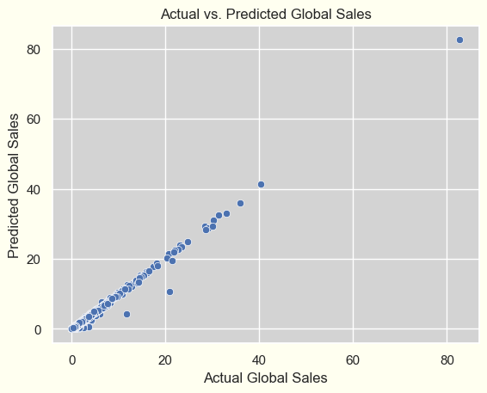

Slide 11


